Slide 1
Fast Plant Classification in a Robotic Application
Master Thesis Presentation
- Priya Konda

Slide 2
Contents
Introduction
Flow Chart
Dataset Preparation
Transfer Learning
Model Re-training
Training Loop
Nvidia Jetson Nano
TensorRT
Image Processing
The Robot
ROS Computational Graph
Results

Slide 3
Introduction
Deep learning in everyday life
Classification, Detection, Segmentation
Ex: Smartphone applications (Translator, Face detection)
Classification: Identifies the correct class based on training dataset.
Uniqueness in features of flower and leaf.
Goal: Practically witness the classification process on a robotic application

Slide 4
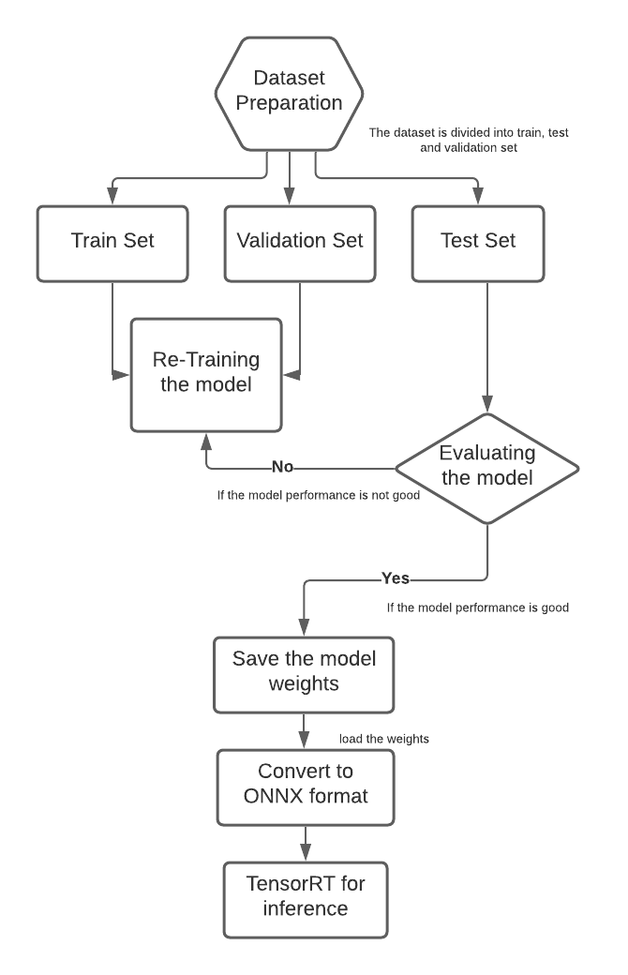
Flow Chart

Slide 5
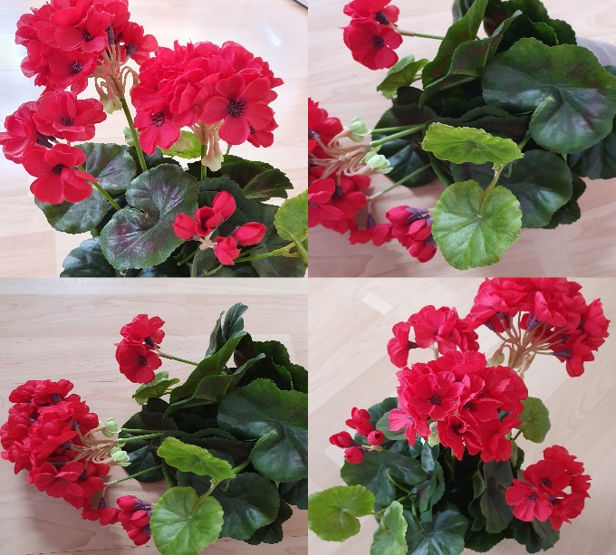
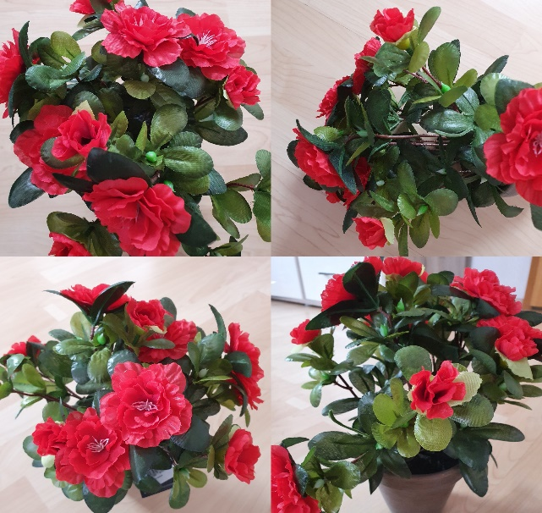
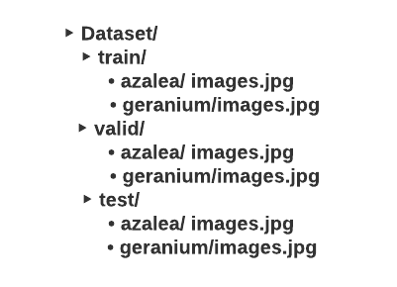
Dataset Preparation
Geranium and Azalea
Balanced dataset
Folder Structure
Images at different angles and position.

Slide 6
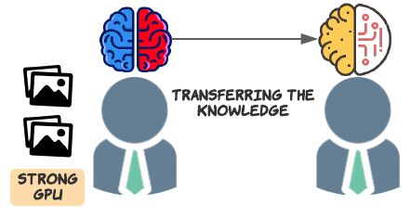
Transfer Learning
Fine Tuning By default requires_grad == True Train all the layers
Fixed Feature Extractor Freeze Initial Layers, requires_grad == False Train the last layer
Torchvision Library model = models.resnet50(pretrained=True)
The image dimensions should match the pre-trained model.

Slide 7
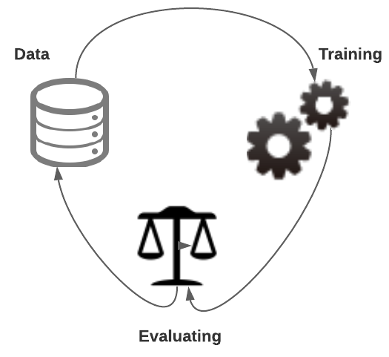
Model Re-training
Quadro P620 and GeForce RTX 2070
alexnet, vgg16, resnet50
Data Augumentation. (flip, crop, resize)
Batch_Size = 4
Train mode - model.train()
Evaluation mode - model.eval()
Trained for 30 epochs
Evaluation using metrics
Saved the model in .pth format
The model is than converted to ONNX format using torch.onnx.export

Slide 8
Training Loop
Forward Pass : Prediction output = model(inputs)
Backward Pass : Loss , Optimizer criterion = nn.CrossEntropyLoss() loss = criterion (outputs, labels) optimizer = optim.SGD(parameters(), lr=0.001, momentum=0.9) Loss.backward()
Update the weights optimizer.step()
Empty the gradients optimizer.zero_grad()

Slide 9
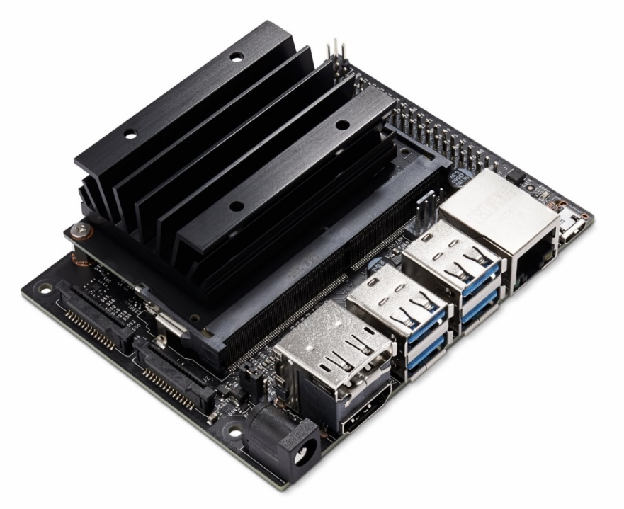
Nvidia Jetson Nano
USB drive, Display and HDMI Port, 5V battery, Ethernet, 4GB RAM, SD card slot.
Nvidia jetpack SDK is flashed on the SD card
Pre-installed software tools
Deploying Deep Learning Repository
Deep Learning Nodes for ROS/ROS2 Repository
DNN Vision library
Image source: https://developer.nvidia.com/embedded/jetson-nano-developer-kit

Slide 10
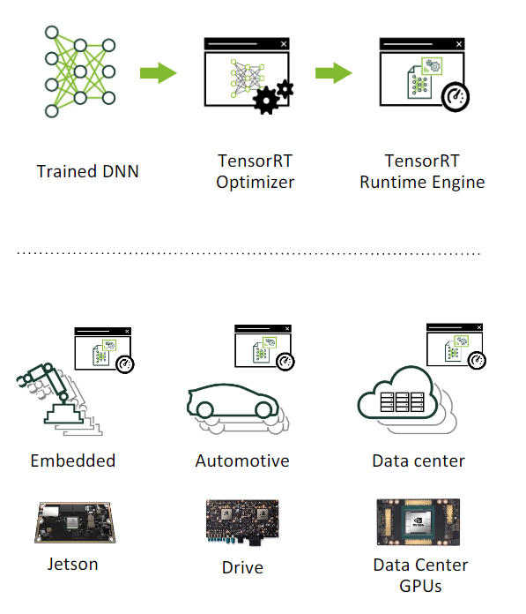
TensorRT
Programmable Inference Acceralator
TensorRT Optimizer Trained model Precision Calibration: float32, float16 or int8
Fix Batch Size
TensorRT Runtime Engine
Storing the Engine file in disk - Serialize
Loading the engine file from memory - Deserialize
Image source: https://docs.nvidia.com/deeplearning/tensorrt/developer-guide/index.html

Slide 11
Image Processing
Speed: Feature Based Method > Deep learning method
Contours on Images
Image Thresholding, Canny Edge Detection
cv2.arcLength, cv2.approxPolyD
Masking the red colour on Images cv2.cvtColor(image, cv2.COLOR_BGR2HSV)
Lower and upper bound is in range, mask=cv2.inRange(image, lower, upper)
Threshold value to grab frame, cv2.countNonZero(mask)

Slide 12
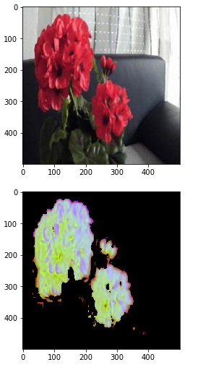
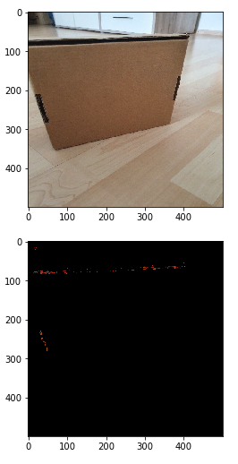
Image Processing

Slide 13
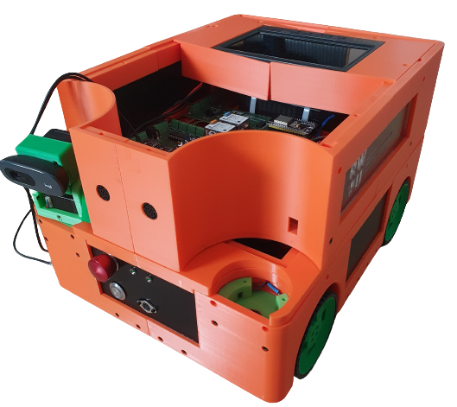
The Robot
Raspberry Pi 4
BeagleBone Blue
Logitech Camera
Batteries
Display screen
Ultrasonic sensors
Standard Wheels
Esp32

Slide 14
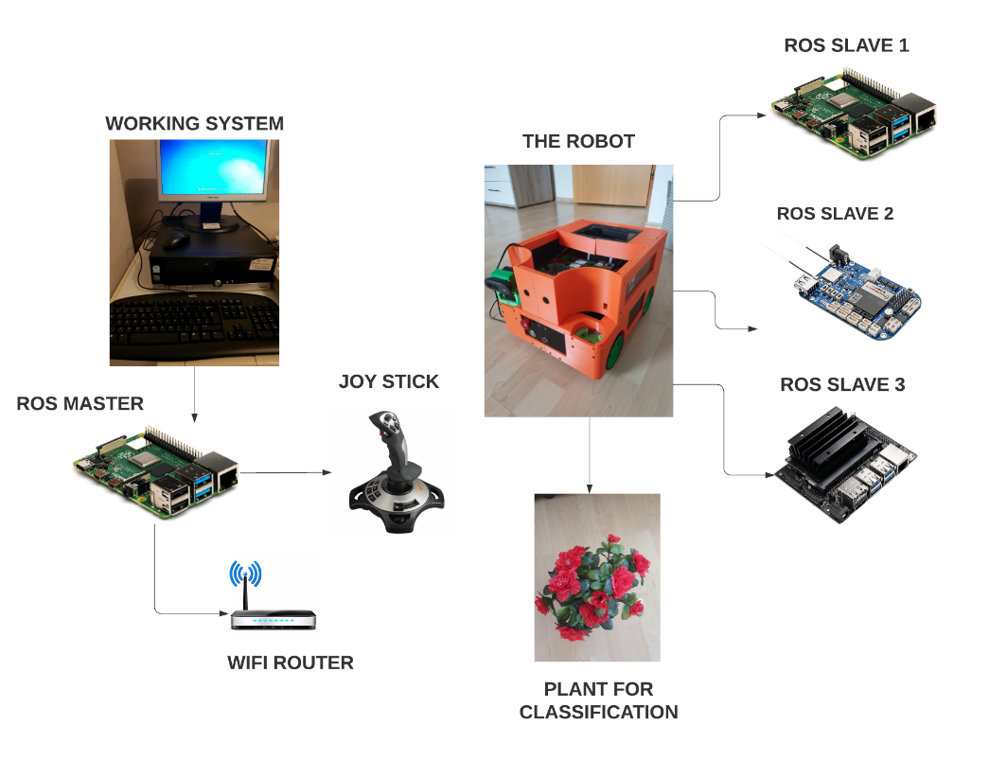
The working

Slide 15
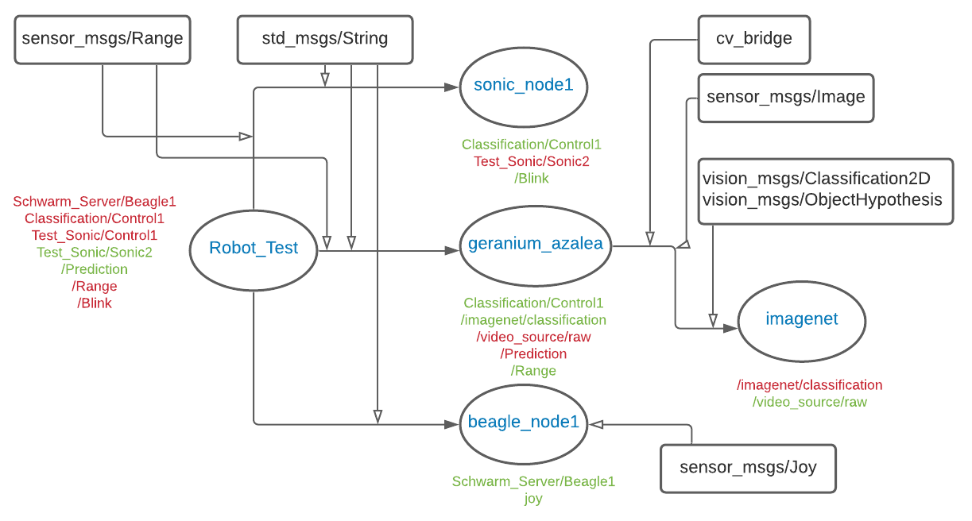
ROS Computation Graph
Node names
Subscribers
Publishers
ROS msgs

Slide 16
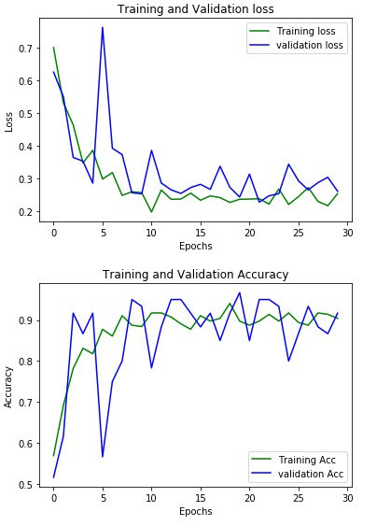
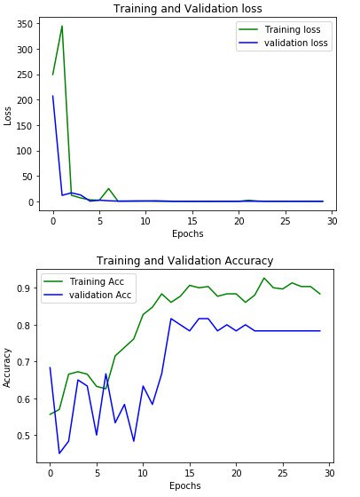
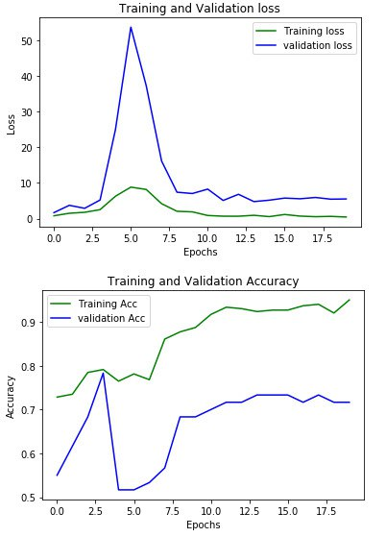
Results
resnet50
alexnet
vgg16

Slide 17
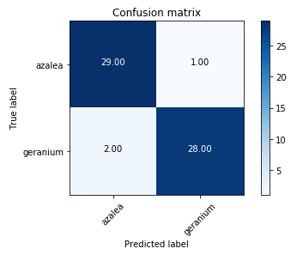
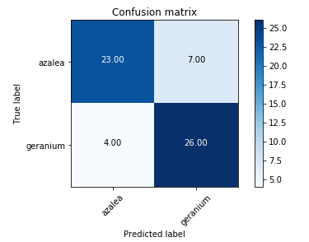
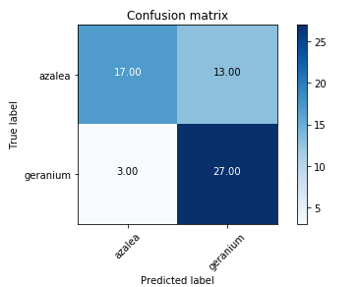
Results
resnet50
alexnet
vgg16

Slide 18
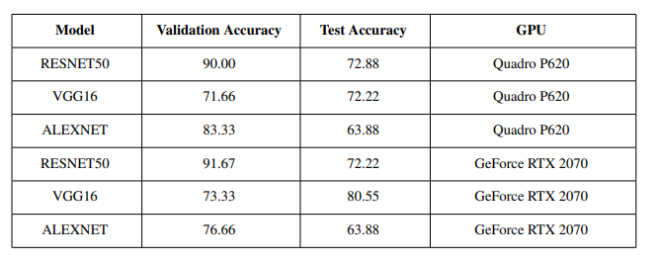
Results

Slide 19
THANK YOU
Prof. Dr.-Ing. Franz Brümmer
Prof. Dr. Jörg Eberhardt
Mr. Torsten Schoder

